Slide 1
ANNUAL RADIATION SAFETY TRAINING
2017

Slide 2
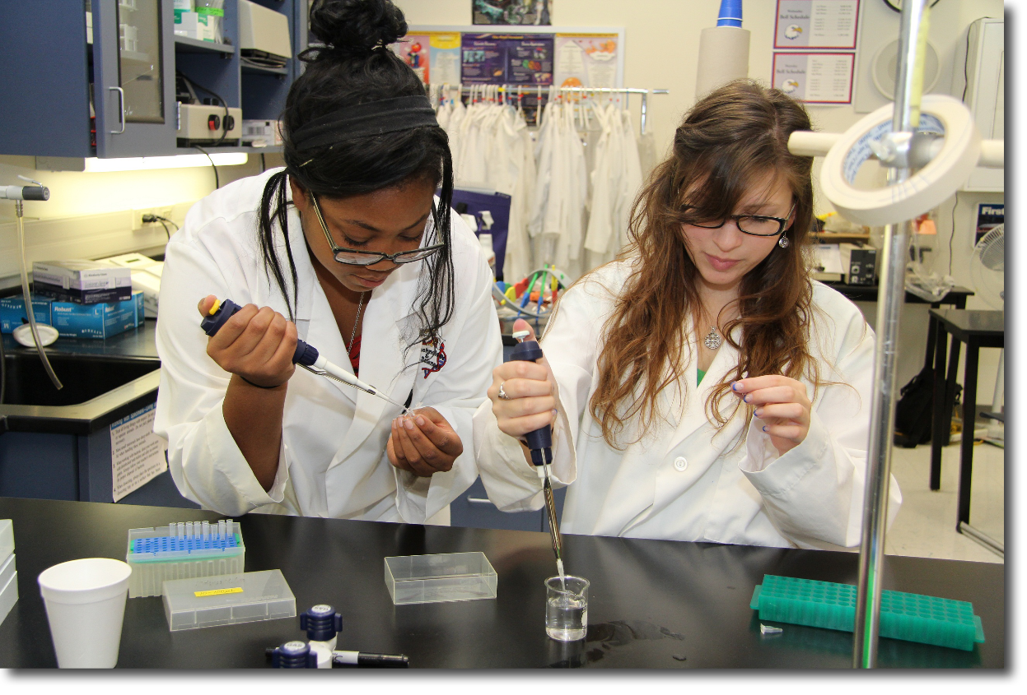
Annual radiation safety training is required of all sublicensees and personnel and/or students who work in an area where radiation is produced or sources are utilized.

Slide 3

The biggest change for this year is the way that radioactive wastes are managed in the laboratory.

Slide 4
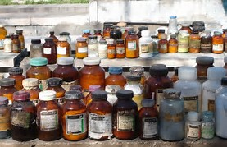
These changes will be similar to those which affect chemical waste.

Slide 5

When radioactive wastes are generated it is placed in temporary storage within the lab where it was generated.This area is designated as a Satellite Accumulation Area (SAA) for radioactive wastes.

Slide 6
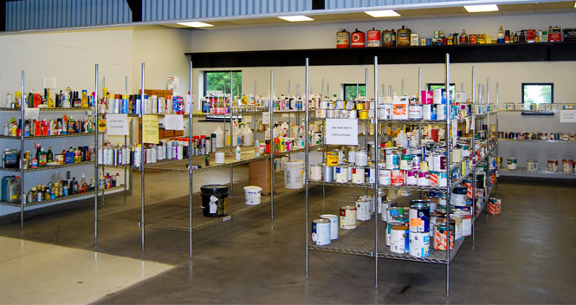
There are a few specific rules that apply to an SAA,but for the most part radioactive waste is managed as it has been for the last few years.

Slide 7
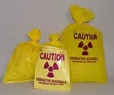
The SAA must be approved by EHS and designated by signage that will be provided by EHS.

Slide 8

SAA radioactive waste must be stored in the same room as the material is generated or in an adjacent room under the same sublicensee.

Slide 9
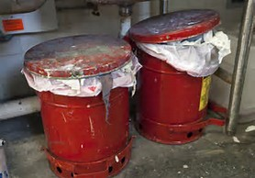
Containers must be kept closed and only opened when material is being added.

Slide 10
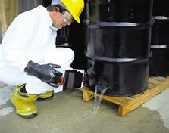
Containers must not be leaking and must be compatible with the contents.

Slide 11
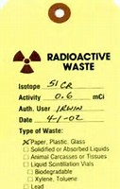
Containers must be labeled with the RSO number,isotope and amount of radioactive material present in the container.If chemical wastes are present they must also be identified.

Slide 12

The way to schedule a pickup is by using the EHS web site.Under the Research heading select radiation safety,then Request Pickup.Material should be picked up by EHS within 3 days of putting it in the SAA.

Slide 13
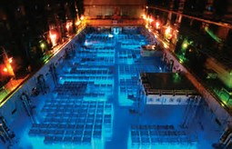
Once material is picked up it is taken to the radioactive waste storage area to be processed and stored.

Slide 14
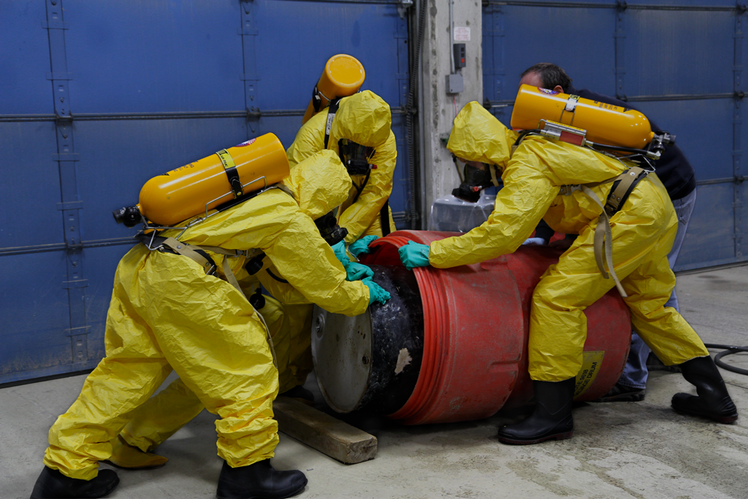
In the event of a spill or emergency alert others and contact EHS at 348-5905.If needed contact UAPD at 348-5454.EHS has a fully equipped haz mat response team.In the event of a fire evacuate.

Slide 15
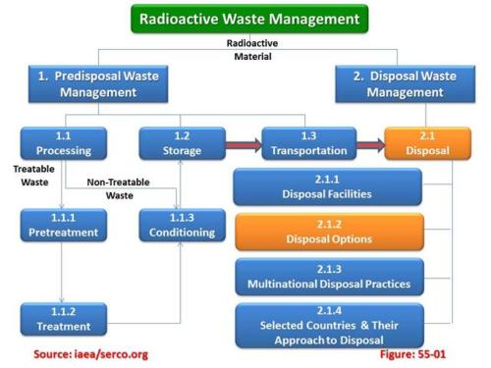
Radioactive waste management is very complex and the regulations are extensive.If you have any questions or need assistance contact EHS at 348-5905.

Slide 16
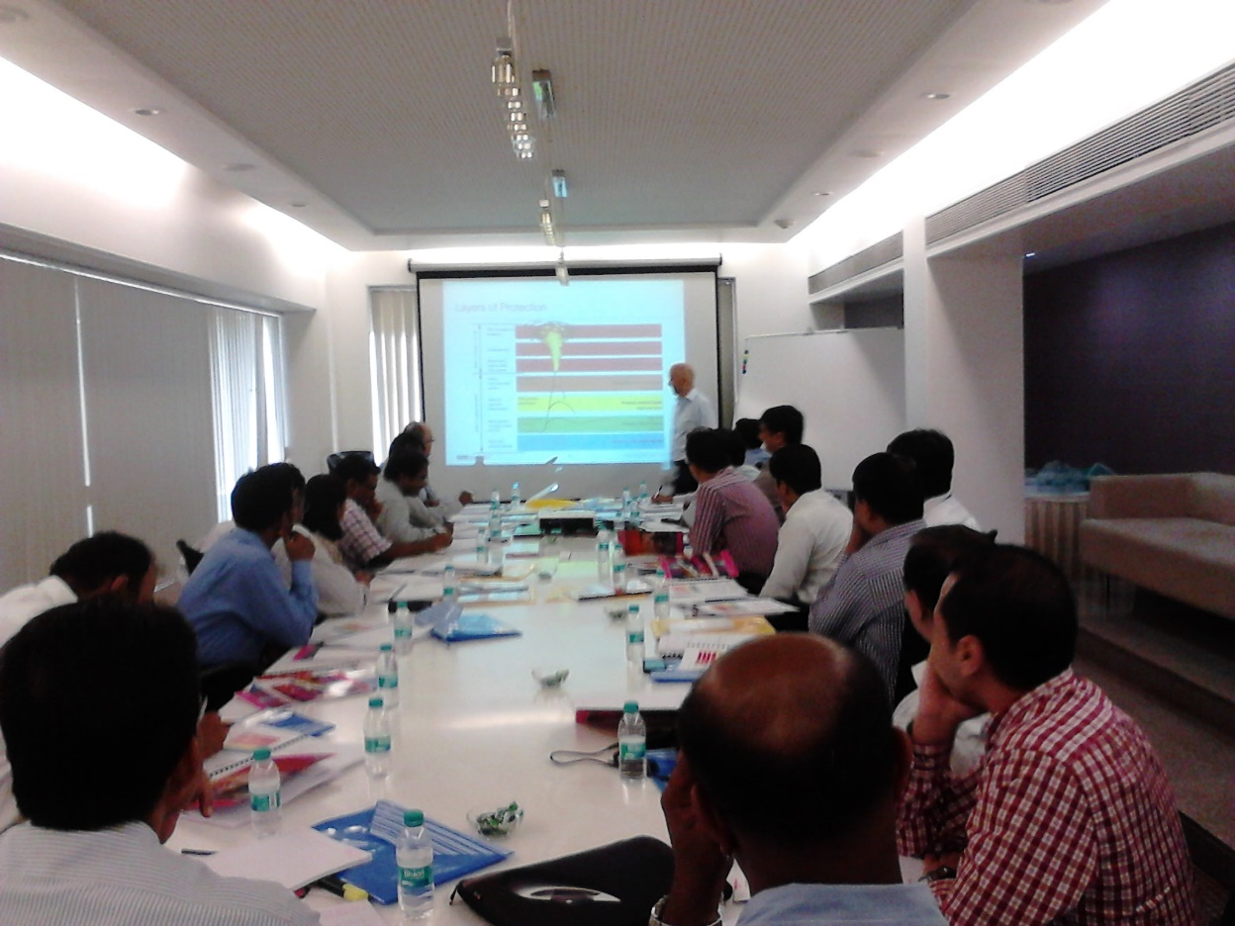
These new waste management requirements will take effect Janurary of 2018.EHS will be contacting all affected sublicensees this fall to establish SAA’s and review the details.

Slide 17
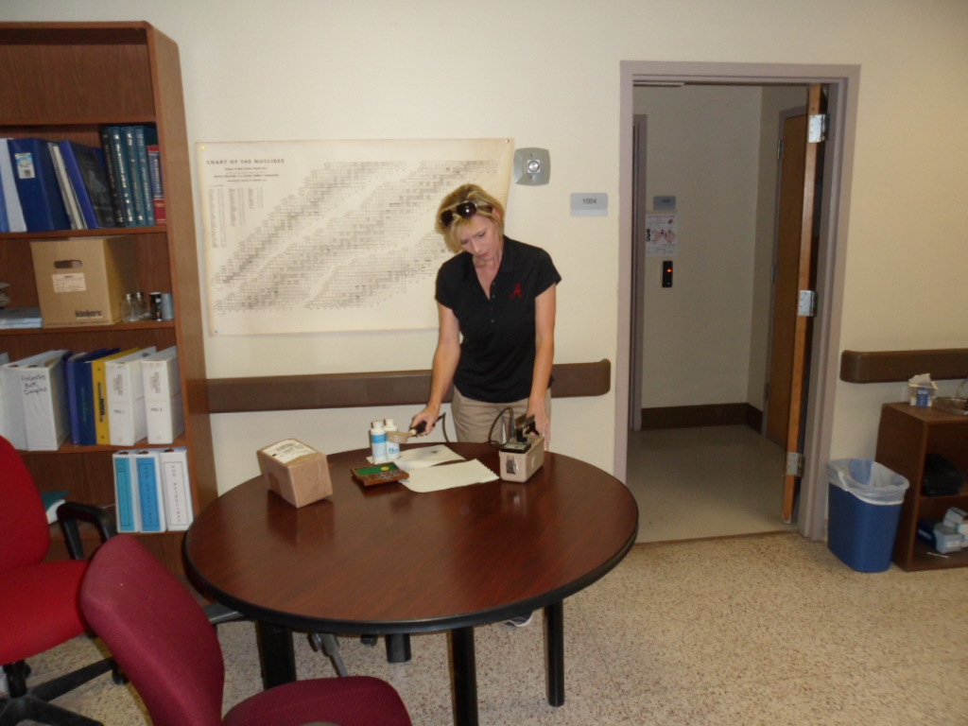
EHS has added a new employee who will be working in radiation safety.She is Telisa Goins.She has completed the 40 hour RSO course and has been approved by the state as Assistant RSO.

Slide 18
Completion
You are almost finished with your annual training for 2017.In order to get credit for completion answer the following 10 questions.Email the answers to EHS along with the information requested on the last slide following question number ten.

Slide 19
1.Who is required to complete annual training?
A.everyone who works with sources of radiation
B.professors
C.sublicensees
D.students

Slide 20
2.Radioactive waste is placed __________________.
A.in bags
B.within the designated SAA for radiation waste
C.in storage
D.in specific DOT containers

Slide 21
3.The radiation waste SAA is __________________.
A.approved by EHS and designated by signage
B.located in departmental offices
C.only for chemical waste
D.changed annually

Slide 22
4.Containers must be ____________________.
A.red
B.emptied when full
C.55 gallon drums
D.kept closed

Slide 23
5.Containers must be ____________.
A.55 gallon drums
B.red
C.compatible with the waste
D.disposable

Slide 24
6.Containers are labeled with________.
A.RSO number,isotope and amount of activity
B.room number,PI,protocol number
C.contents
D.emergency information

Slide 25
7.Schedule a pickup by ____________________.
A.contacting the RSO
B.notifying the Chair of the RCAC
C.signing up on the waiting list
D.complete a pickup request on the EHS web site

Slide 26
8._______ is responsible for picking up and managing radioactive waste.
A.The sublicensee
B.The NRC
C.EHS
D.The Radiation Control Advisory Committee

Slide 27
9.If you need assistance with a spill contact ___________________.
A.the NRC
B.your nearest physicist
C.EHS
D.housekeeping

Slide 28
10.The new radioactive waste requirements will take effect ________.
A.immediately
B.Jan 2018
C.Fall 2018
D.November 17,2015

Slide 29
Email your answers to the 10 questions to tgoins@fa.ua.edu along with your name,CWID,the room number and building where you will be working with radiation sources.You must do this to get credit for annual training.

