Slide 1
EHS RADIATION SAFETY TRAINING
This training is required of all persons who work with radioactive materials or radiation producing machines.It should be completed prior to any work with sources.If you need further information or have questions contact EHS at hbarrett@fa.ua.edu or 348-5905.In order to get credit for initial training follow the instructions on the last slide.

Slide 2
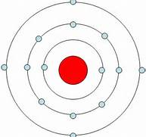
The Bohr Model
The Bohr atomic model is a central nucleus composed of neutrons and protons surrounded by electrons.The number of electrons and protons are equal.

Slide 3
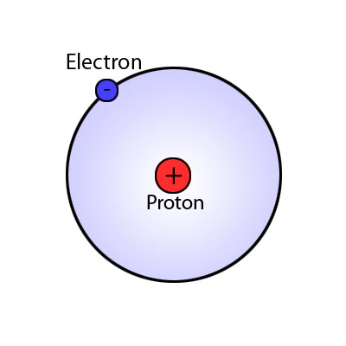
Protons have a positive charge.Neutrons have no charge.Electrons have a negative charge

Slide 4
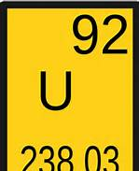
The atomic number is the number of protons in the nucleus.For example the atomic number for Uranium is 92.

Slide 5
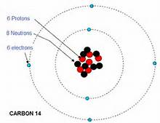
An element may have several isotopes.An isotope has the same number of protons but a different number of neutrons.C14,S35 and P32 are examples of isotopes.

Slide 6
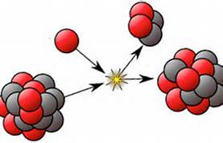
Many isotopes are stable.However unstable isotopes release energy by radioactive decay.

Slide 7
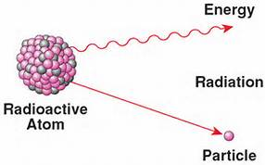
Radioactivity is the natural and spontaneous process by which an unstable isotope decays to a different state and emits excess energy in the form of particles or waves.

Slide 8
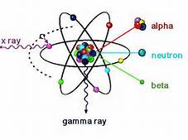
Examples of ionizing radiation
Alpha particles
Beta particles
Gamma rays
Neutrons
Xrays

Slide 9
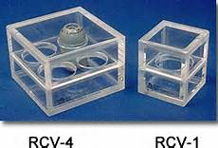
An isotope decays through a specific set of transformations in an effort to reach stability.For example P32 to S32 is accompanied by the emission of a beta particle.

Slide 10
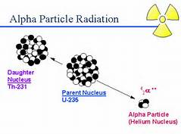
Alpha particle
Composed of 2 neutrons and 2 protons.They are relatively heavy and will travel only a short distance.

Slide 11

Alpha particles are easily sheilded and cannot penetrate the skin.

Slide 12

Alpha particles do not present an external exposure hazard.However they can present a serious hazard if inhaled or ingested.

Slide 13
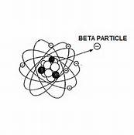
Beta particle
A beta particle is an electron emitted from an atom.Examples of beta emitters commonly used on campus are H3,C14,P32 and S35.

Slide 14
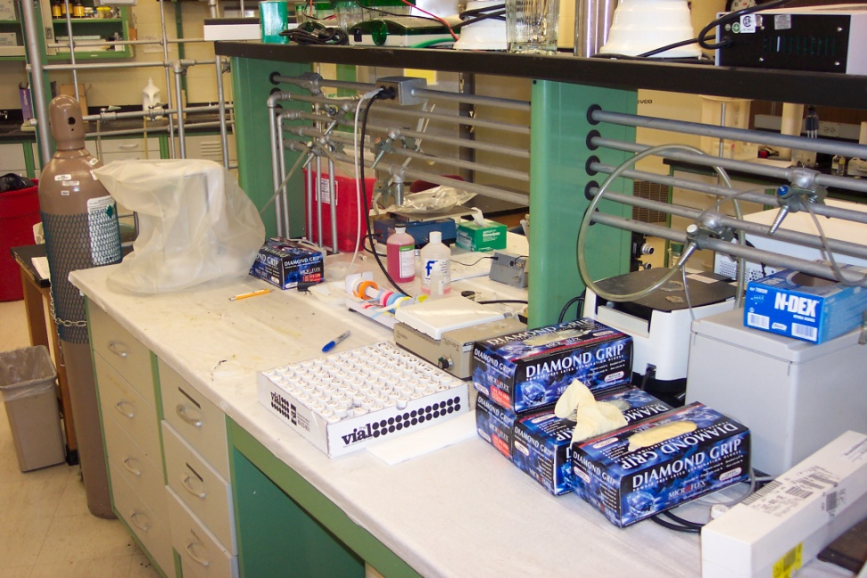
Beta particles have a longer range than alphas.High energy betas (P32) can penetrate the skin while low energy betas (H3) cannot.

Slide 15
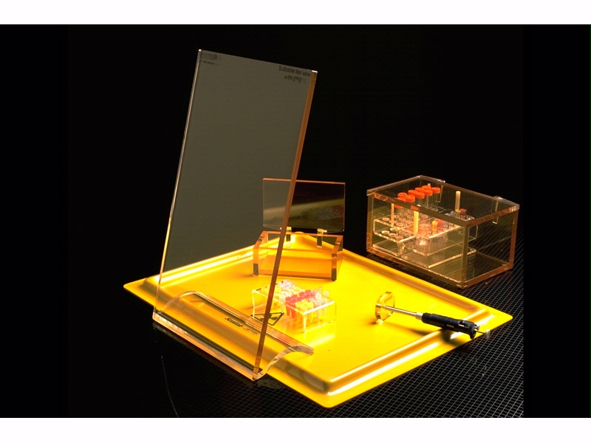
Beta particles may require sheilding.All present a problem if inhaled,absorbed or ingested.

Slide 16
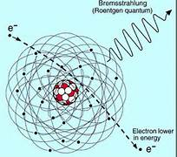
Bremsstrahlung
A secondary xray radiation produced when beta particles pass near the nuclei of atoms.Can be a problem with high energy beta emitters like P32.

Slide 17
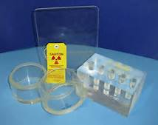
To reduce bremsstrahlung use plexiglass sheilding for beta emitters instead of lead.

Slide 18
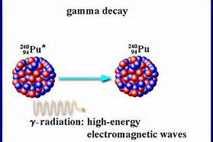
Gamma Rays
A gamma ray is a photon of electromagnetic radiation emitted from the nucleus during decay.

Slide 19
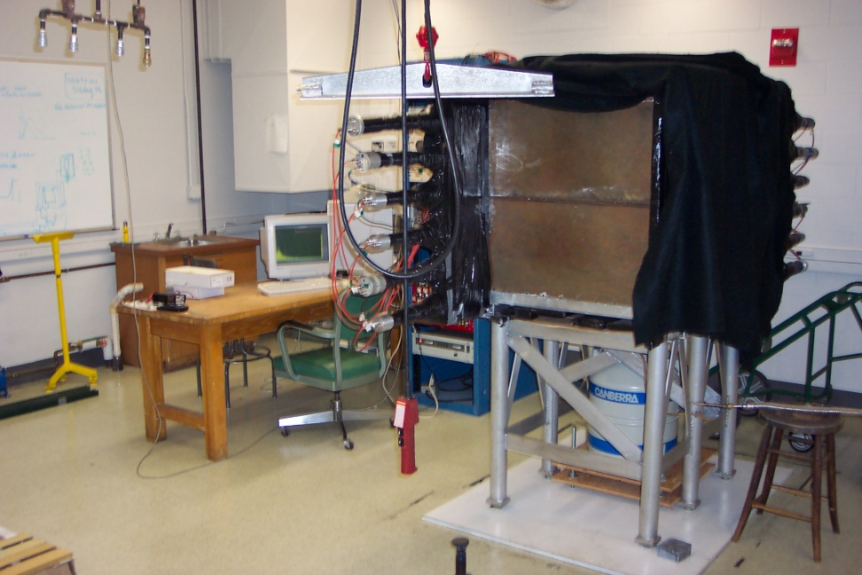
Gamma rays are high energy with no mass or charge and can travel significant distances.

Slide 20
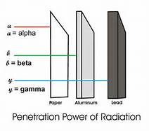
Gamma radiation is an external hazard.Sheilding is typically very dense for example lead.

Slide 21
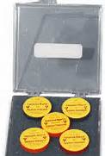
Gamma emitters commonly used on campus are Co60,Cs137 and Ra226.

Slide 22
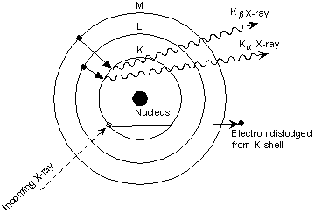
X-rays
Produced as the result of changes in the positions of electrons as they shift to different energy levels.

Slide 23
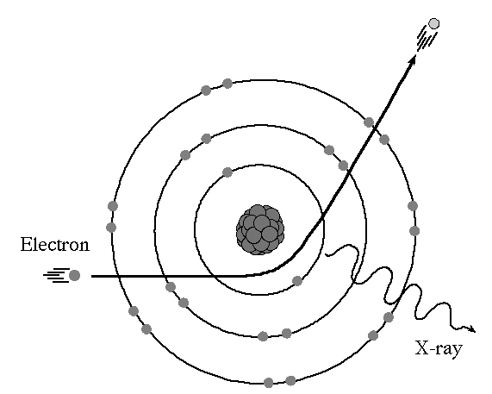
Xrays can be produced as a result of decay or by Bremstrahlung radiation.

Slide 24
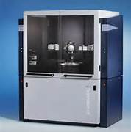
Sources of xrays on campus include isotopes such as I125 and I131 and analytical xray machines.

Slide 25
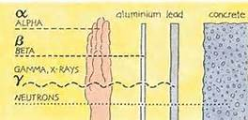
Neutron Radiation
Neutron radiation was discovered as a result of observing beryllium interacting with an alpha particle and emitting a neutron.

Slide 26
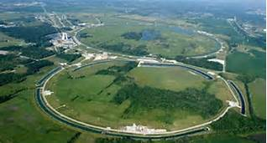
Neutron radiation normally comes from sources such as nuclear reactors or particle accelerators.

Slide 27
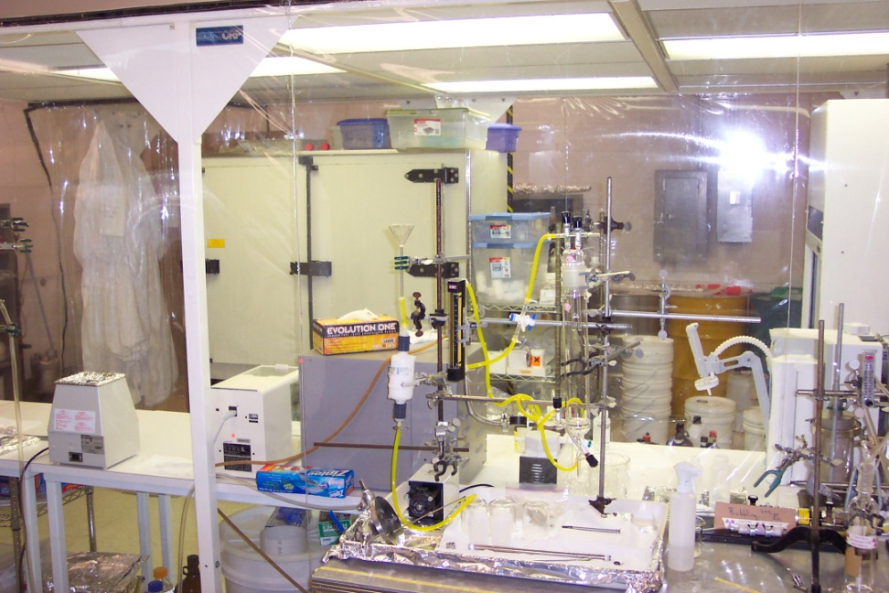
Activity
Quantities of radioactive material is measured in activity rather than mass.Activity is the number of disintegrations per a given period of time.

Slide 28
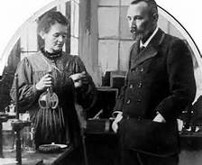
The most common units of activity are the Curie or the Becquerel (SI).

Slide 29
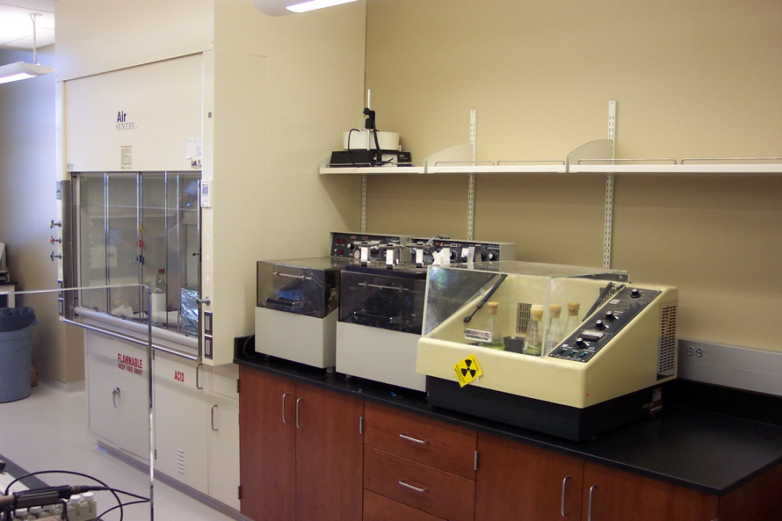
1 Curie (Ci) =3.7x10(10) disintegrations per sec
1 Becquerel (Bq)= 1 disintegration per sec

Slide 30
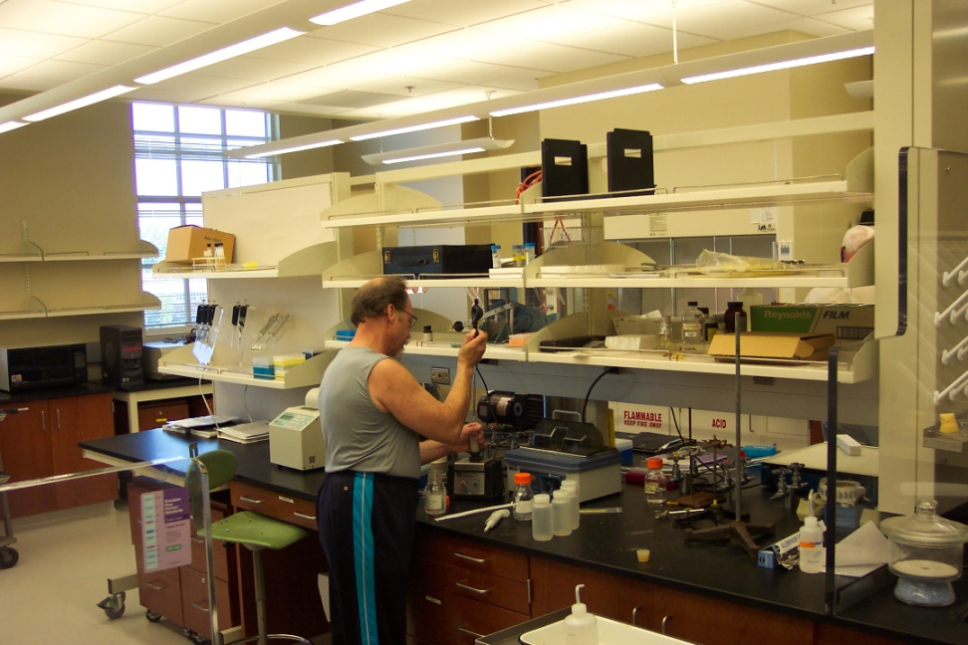
Normally at UA millicurie or microcurie amounts are generally used.
1 mCi=2.2x10(9) dpm=3.7x10(7) Bq
1 uCi=2.2x10(6) dpm=3.7x10(4)

Slide 31
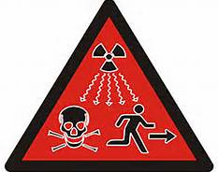
Intensity
A more useful way to describe potential hazard than activity.

Slide 32
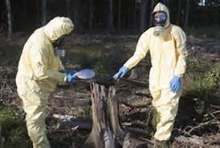
Exposure,absorbed dose and dose equivalent are the quantities which describe radiation intensity.

Slide 33
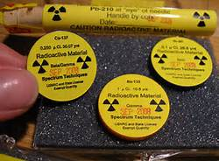
Exposure is expressed in units of Roentgen (R) or Coulombs/kg.It is the amount of charge produced in 1 kg of air by x or gamma rays.
1R=2.58x10(-4) Cb/kg

Slide 34
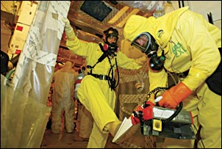
Absorbed dose is expressed in units of Rad or Gray.It is the amount of energy absorbed in 1 gram of matter from radiation.
1 rad=100ergs/gram
1 Gray=100 rad

Slide 35
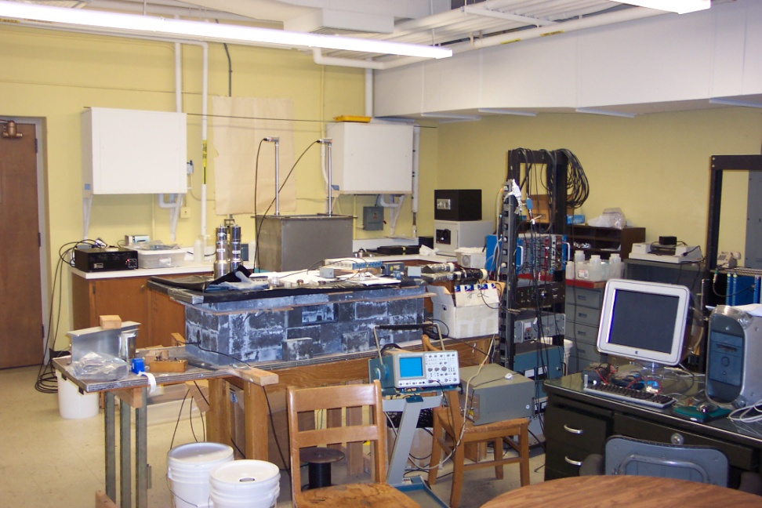
Dose equivalent is expressed in units of Rem or Seivert.It is absorbed dose modified by the ability of the radiation to cause biological damage.
Rem=rad x quality factor
1 Sv=100 rem

Slide 36
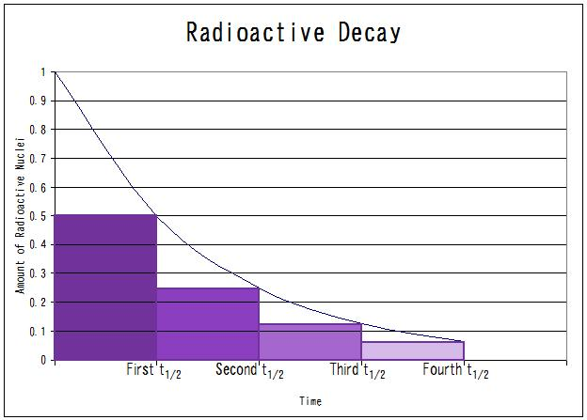
Half Life
Radioactive materials decay at rates unique to each isotope.The half life is the time required for the material to be reduced to ½ of its original activity.

Slide 37
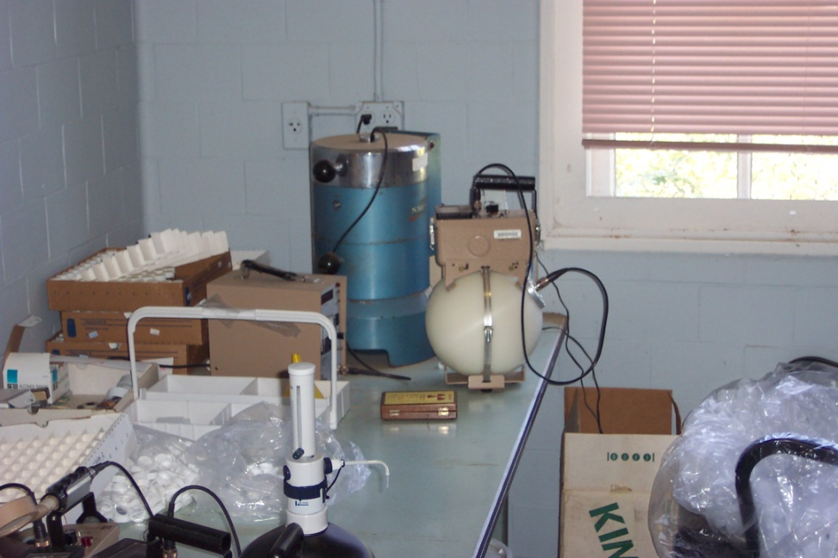
Half life of commonly used isotopes:
H3 12.3 yrs
C14 5730 yrs
P32 14.3 days
S35 87.6 days
I125 60.1 days

Slide 38
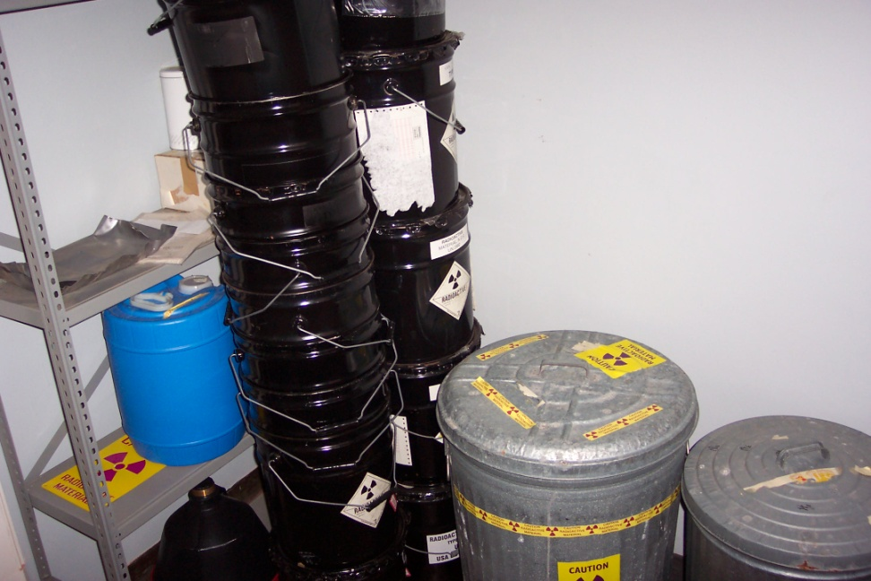
When a material goes through 10 half lives the activity is considered to be zero.

Slide 39
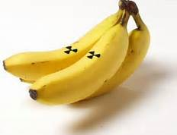
Background Radiation
We are all exposed to ionizing radiation from natural sources constantly.

Slide 40
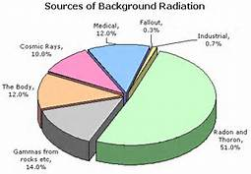
Sources of background radiation include radioactive material and gasses naturally in the earth,cosmic rays and trace amounts of isotopes present in the body.

Slide 41
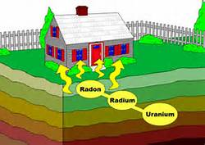
Sources in the earth include long half life isotopes and their decay products for example uranium-thorium-radon.

Slide 42
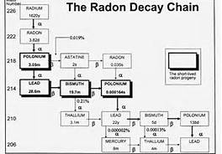
Geologically speaking exposure to radon gas
is not a problem in the Tuscaloosa area.

Slide 43
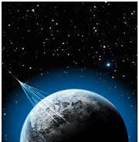
Cosmic rays are high energy particles which originate in stars.Exposures at high altitudes are greater than those at sea level.

Slide 44

Natural radioactivity in the body comes from isotopes present in our food,water and air we breathe.The most common isotopes are H3,C14 and K40.

Slide 45
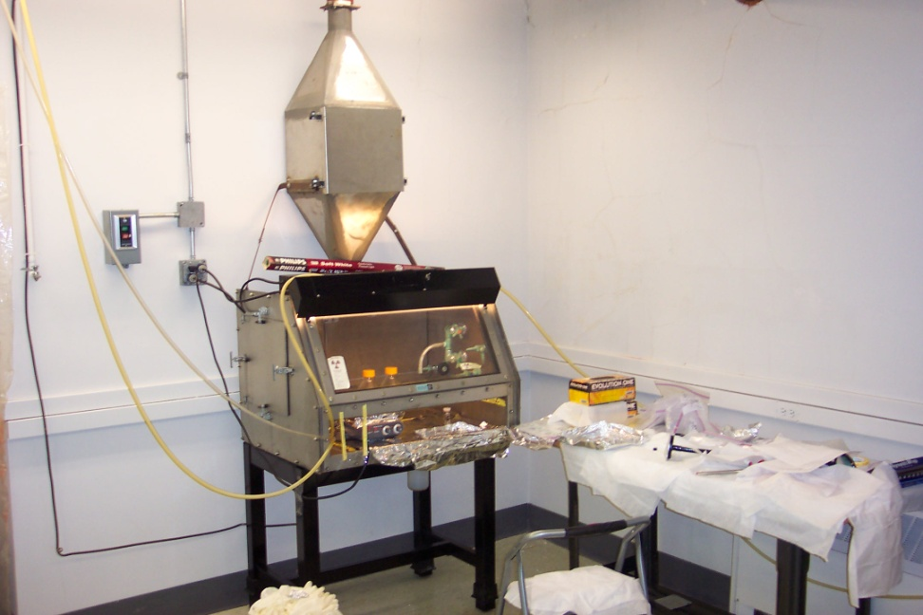
Radiation dose to U.S.population:
Cosmic 31
Terrestrial 19
Radon 229
Internal 16
Medical 300
Others 25
Avg.annual total 620 mrem/yr.

Slide 46
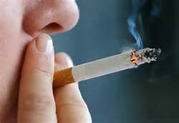
Average doses from common activities:
Smoking 280 mrem/yr
Working in UA lab <1
Xrays 20
Drinking water 5
Cross country flight 5
Coal burning 0.165

Slide 47

Biological Effects
Injury to living tissue results from the transfer of energy to atoms and molecules in the cellular structure.

Slide 48
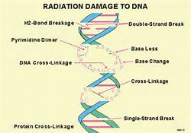
The mechanisms of damage include:
Producing free radicals
Breaking chemical bonds
Producing new chemical bonds
Damaging molecules that regulate cell processes (DNA,RNA).

Slide 49
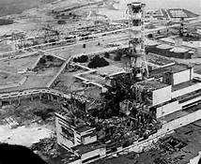
At low doses cellular damage can be rapidly repaired.At higher doses cell death may result.

Slide 50
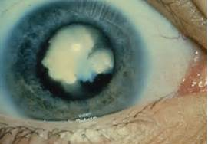
Tissues are not equally sensitive to radioactivity.

Slide 51
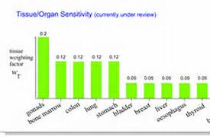
In general tissue sensitivity is proportional to the rate of proliferation of cells and inversely proportional to the degree of cell differentiation.

Slide 52
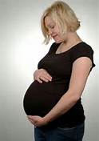
The blood forming and reproductive organs are the most sensitive tissues.A developing embryo is at it’s most sensitive early in the pregnancy.

Slide 53

Radiation effects may be prompt or delayed.

Slide 54
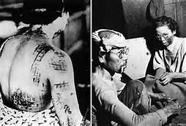
Prompt effects occur after large doses of radiation over a short period of time.

Slide 55
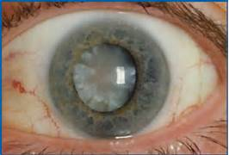
Delayed effects appear months or years following a radiation exposure.

Slide 56

Prompt effects:
Blood count 50 mrem
Vomiting 100 mrem
100% death 800 mrem
LD 50/60 500 mrem

Slide 57
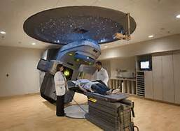
Effects can be very different when only portions of the body are irridated.For example a full body dose of 500 mrem may be fatal.The same dose could be delivered as a medical treatment.

Slide 58

Leukemia,multiple myeloma,breast and lung cancer may be induced by high doses.

Slide 59

People associate exposure to radiation with an increased risk of cancer.A dose of 10 mrem creates a risk factor of death from cancer at 1 in 1 million.

Slide 60

Other activities with a 1 in 1 million risk of death from cancer:
Smoking 1.4 cigarettes during your life
Spending 2 days in NY
Driving 40 miles
Flying 2500 miles
Canoeing for 6 minutes

Slide 61

There is little evidence of radiation induced genetic effects in humans.

Slide 62

Prenatal exposure can result in low birth weight,mental retardation and other neurological problems.

Slide 63

Regulatory Elements
The University of Alabama has been issued a license by the Alabama Department of Public Health.

Slide 64

This license is issued by the State and specifies amounts,locations and conditions under which UA may use isotopes and equipment.

Slide 65

A copy of The University license is available from EHS

Slide 66

The State conducts periodic unannounced inspections of UA.

Slide 67

A major part of this inspection is visiting labs and interviewing sublicensees and users.

Slide 68

If an inspector visits your lab answer their questions directly.Do not volunter information or ramble.Simply wait until the next question is asked.

Slide 69

Radiation Safety Program
The Radiation safety program is made up of four key elements:
The RCAC
EHS
Sublicensees
Users.

Slide 70

The Radiation Control Advisory Committee (RCAC) is responsible for oversight of the program,advises the RSO and authorizes the use of radiation sources.

Slide 71

The RCAC is made up of faculty and staff who have experience working with radioactive materials or equipment.

Slide 72

All types of users are represented on the RCAC.This includes sealed sources,unsealed sources and xray producers.

Slide 73

EHS manages the Radiation safety Program.The Radiation Safety Officer is Hal Barrett Director of EHS.

Slide 74

Sublicensees are faculty or staff who are authorized by the RCAC to supervise labs where radioactive sources or machines are used.

Slide 75

Users are faculty,staff,students or visitors who work with radioactive materials or machines under the supervision of the sublicensee.

Slide 76

Dose/Exposure Limits
Dose limits are established by the State:
Whole body 5 rem/yr
Lens of eye 15 rem/yr
Extremities 50 rem/yr
Skin 50 rem/yr
Fetus 0.5 rem/9 mo

Slide 77

The exposure limit for a minor is 10% for that of an adult.

Slide 78

Exposure limit for the general public is 100 mrem/yr.

Slide 79

EHS investigates any quarterly exposures above 100 mrem/quarter.Over the past 10 years there have been no exposures at UA that required investigation.

Slide 80

All radiation work must be done with the ALARA exposure principle in mind.
A-As
L-Low
A-As
R-Reasonably
A-Achievable

Slide 81

Time,distance and sheilding are very good ALARA techniques to limit exposures.

Slide 82

Any sublicensee or user who is pregnant should notify the RSO.The RSO will provide risk information and evaluate potential exposures.

Slide 83

EHS Responsibilities
EHS is responsible for the management of the radiation safety program and the daily functions that are necessary to support the program.

Slide 84

The Radiation safety Officer (RSO) is Hal Barrett ,Director of EHS.The RSO position goes through a state approval process.

Slide 85

Dosimetry is provided by EHS to monitor exposures.

Slide 86

When new users begin work their sublicensee requests personal dosimetry from EHS if it is appropriate.

Slide 87

Source labs which only use H3 or C14 are not issued dosimetry.The energy is too low to be detected.

Slide 88

Analytical x-ray labs are provided with area monitors

Slide 89

Temporary personal dosimetry may be issued to visitors if necessary.

Slide 90

EHS changes out dosimetry quarterly.

Slide 91

Three types of radiation safety training are provided.These are:
Initial
Lab Specific
Annual.

Slide 92

Initial training is provided by EHS prior to working with sources.

Slide 93
Lab specific training is provided by the sublicensee to lab users.

Slide 94

Annual training is provided by EHS.All sublicensees and users are required to complete each year.

Slide 95

EHS conducts an annual audit of each area approved for work with radiation sources.

Slide 96

EHS checks security each time the lab is visited.Labs must be locked when no authorized users are present and sources must always be secured.

Slide 97

EHS conducts monthly contamination surveys of all labs that are sublicensed to use unsealed sources.

Slide 98

Sealed source inventories are conducted quarterly by EHS.This includes checking for leakage.

Slide 99

A monthly inventory of all sources is provided by EHS to sublicensees.Each sublicensee should verify the accuracy of their inventory.

Slide 100

Signage including the EHS Emergency Procedures and Notice to Employees are posted in each approved area.

Slide 101

EHS checks meters annually to determine efficiency against a source of known activity.

Slide 102
Survey meters are not very efficient.Do not look at the readout.Compare the difference in the number of clicks for background versus a source to determine if contamination is present.

Slide 103

All purchases of radiation sources must be approved by EHS prior to purchase.Obtain an approval number first.

Slide 104

All purchases of sources must be shipped directly to EHS for processing and contamination testing.

Slide 105

Once processed and cleared packages will be delivered to the lab by EHS.

Slide 106

All off campus shipments of radioactive material must be done by EHS.Jeff Hallman has the training to manage these shipments.

Slide 107

Radioactive waste is picked up , managed and disposed of by EHS.

Slide 108

The UA Radiation Safety Manual goes into much more detail regarding program requirements.It is available on the EHS web site.

Slide 109

You have almost completed initial training.To get credit E mail the answers to the following 25 questions to hbarrett@fa.ua.edu you will then be provided annual training.

Slide 110
1.An isotope has the same number of ____.
A.electrons and protons
B.protons different number of neutrons
C.protons different number of electrons
D.protons as neutrons

Slide 111
2.Which is not an example of ionizing radiation___________.
A.xrays
B.alpha
C.gamma
D.lasers

Slide 112
3.A beta particle is _______.
A.highly charged
B.an electron emitted from an atom
C.very small
D.able to penetrate 1 inch of lead sheilding

Slide 113
4.Bremsstrahlung may be reduced by______.
A.lead sheilding
B.xrays
C.time and distance
D.using plexiglass sheilding instead of lead

Slide 114
5.A common gamma emitter is______.
A.P32
B.C14
C.very dangerous
D.Cs137

Slide 115
6.Xrays are produced by _____.
A.large machines
B.decay or Bremsstrahlung
C.alpha emitters
D.C14

Slide 116
7.___is the number of disentigrations per a given period of time.
A.Xrays
B.Gamma radiation
C.2.2 x 10 (-6)
D.Activity

Slide 117
8.Exposure is expressed in units of ____.
A.Roentgen
B.activity
C.curies
D.isobars

Slide 118
9.The half life of C14 is ________.
A.14.3 days
B.5 hrs
C.5730 years
D.12.3 yrs

Slide 119
10.When a material goes through 10 half lives the activity is considered______.
A.nanocuries
B.1.13x10 (-10)
C.picocuries
D.zero

Slide 120
11.The average annual radiation dose to an individual in the US is _________.
A.due to medical tests and treatment
B.620 mrem/yr
C.greater than 100 but less than 1000
D.zero

Slide 121
12.All tissues are equally sensitive to radiation.
True
False

Slide 122
13.UA is licensed by ___to use radiation sources.
A.the NRC
B.the atomic energy commission
C.Ala Dept of Public Health
D.the DOE

Slide 123
14.____are authorized by the RCAC to supervise labs.
A.Sublicensees
B.Departmental chairs
C.TA’s
D.Tenured faculty

Slide 124
15.The 3 types of sources are _______.
A.hazardous,nominal,non haz
B.sealed,unsealed,xray
C.large,small,median
D.regulated,exempt,other

Slide 125
16.The whole body dose limit is _____.
A.10 curies
B.5 rem/yr
C.15mrem
D.5 Roentgen

Slide 126
17.The exposure limit for a minor is ____ of an adult.
A.one half
B.twice
C.10%
D.equal to that

Slide 127
18.Any quarterly exposures above ____ are investigated.
A.10 microcuries
B.5 Roentgens
C.background
D.100 mrem

Slide 128
19.ALARA means_______.
A.as long as reason allows
B.as long as regs allow
C.as lenghtly as rem accumulates
D.as low as reasonably achievable

Slide 129
20.____ are very good ALARA techniques.
A.Lead and bricks
B.Time ,distance and sheilding
C.Duck and run
D.Hand washing and vaccination

Slide 130
21.Dosimetry is changed out _____.
A.as needed
B.monthly
C.quarterly
D.annually

Slide 131
22.____handles all off campus shipments of radioactivity.
A.UPS
B.Post office
C.Fed ex
D.EHS

Slide 132
23.All purchases must be ______.
A.prior approved by EHS
B.small exempt quantities
C.shipped by UPS
D.made by P card

Slide 133
24.Labs must be ____ when no authorized users are present.
A.guarded
B.monitored
C.locked
D.available for use

Slide 134
25.An annual audit is conducted by______.
A. state inspectors
B.NRC
C.DOE
D.EHS

Slide 135
Return the answers along with your CWID and the room number and building where you will work with radioactive materials or machines and the sublicensee for that lab to tgoins@fa.ua.edu .You must also complete annual training which is available on the EHS web site.

